Slide 1

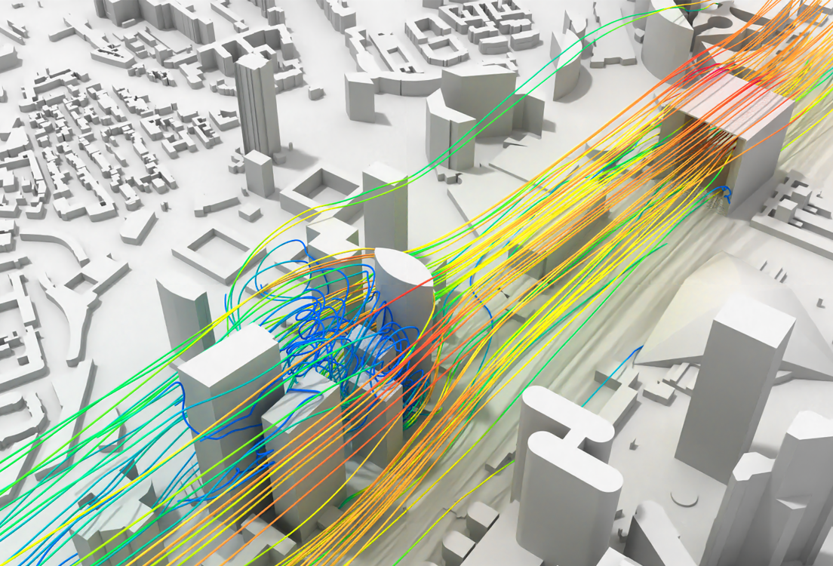
Bank of America Plaza, Atlanta Structural Wind Engineering
Javad Mohebi
Rodrigo Castedo-Hernández
Raúl San Miguel Peñas
Computational Mechanics
Technische Universität München
March 2, 2023
Technische Universität München 2022

Slide 2

Agenda
Intro…
Fig. 1: Bank of America Plaza [1]
Technische Universität München 2022

Slide 3
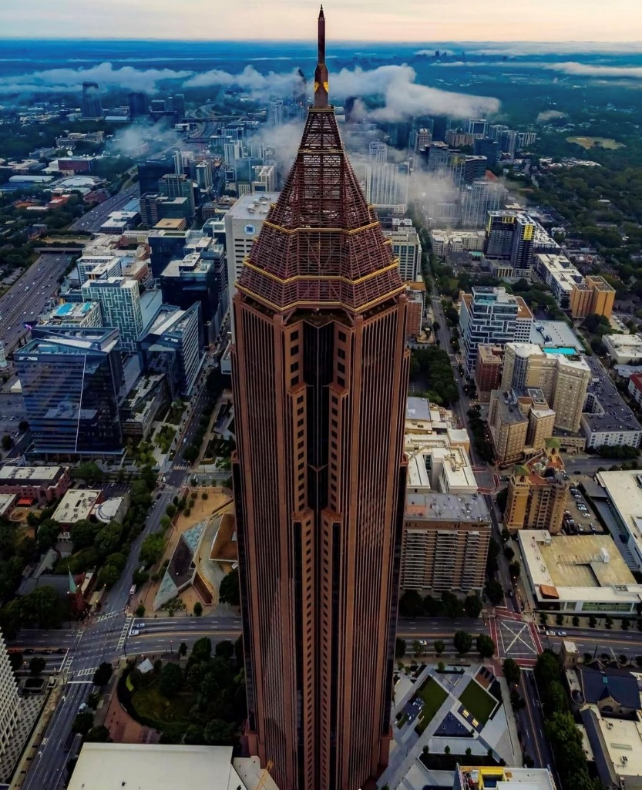
The Structure
Bank of America Plaza:
Height: 250 m
Floors: 55
Width: 55 m
Material: Concrete-Steel Composite
Year completed: 1992
Assumptions:
The cross-section shape is taken as square
The top hollow part is not considered
Fig. 2: Bank of America Plaza [1]
3
Technische Universität München 2022

Slide 4
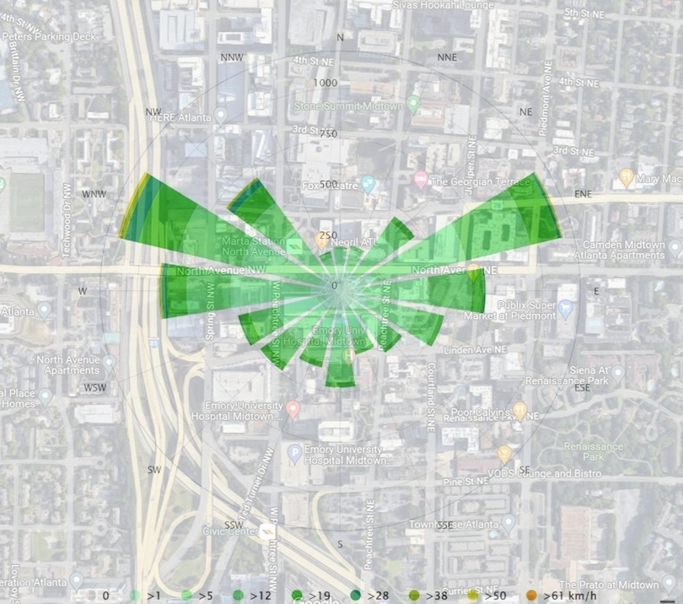
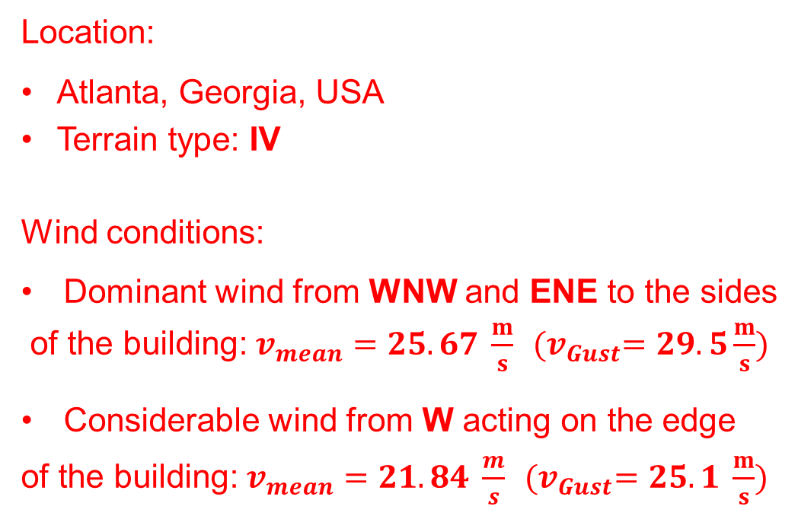
Location and wind conditions
Location:
Atlanta, Georgia, USA
Terrain type: IV
Wind conditions:
Dominant wind from WNW and ENE to the sides
of the building: $v_{mean}=25.67 \frac{m}{s}$ ${(v}_{Gust}=29.5\frac{m}{s})$
Considerable wind from W acting on the edge
of the building: $v_{mean}=21.84 \frac{m}{s}$ ${(v}_{Gust}=25.1 \frac{m}{s})$
Fig. 3: Wind rose according to 30 years data [2]
4
Technische Universität München 2022

Slide 5
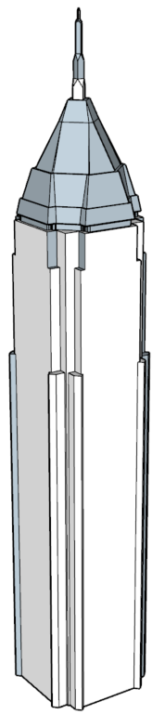
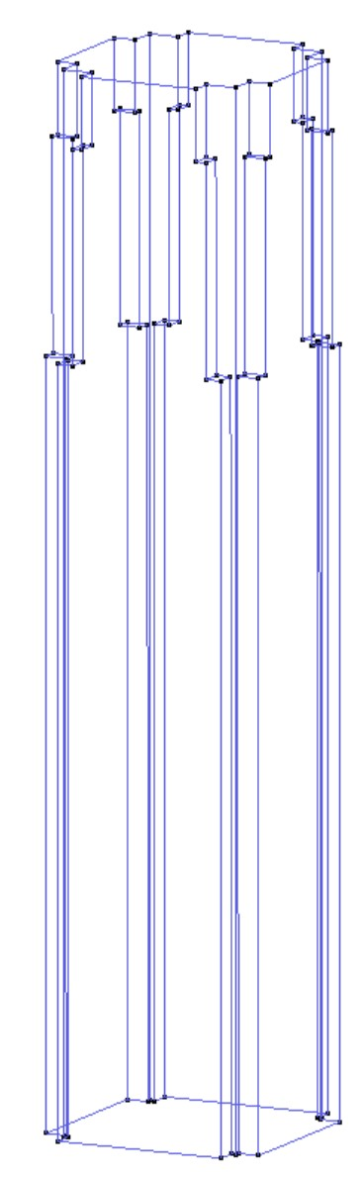
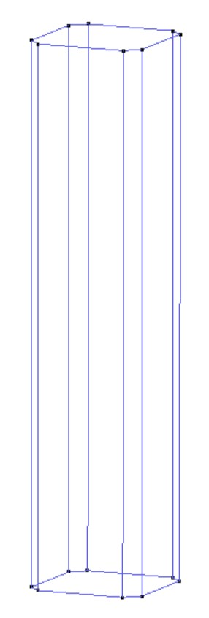
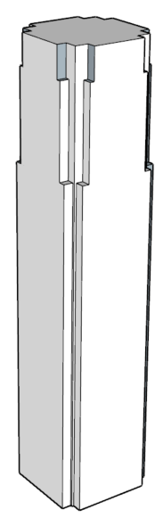
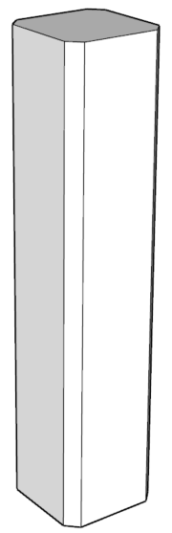
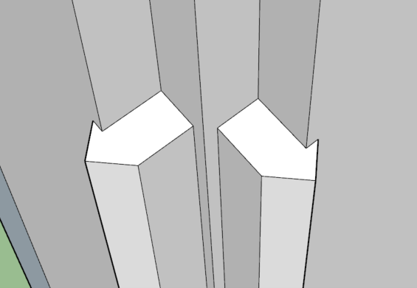
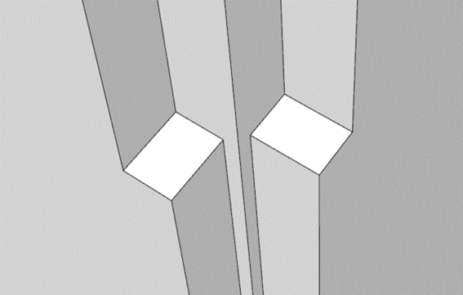
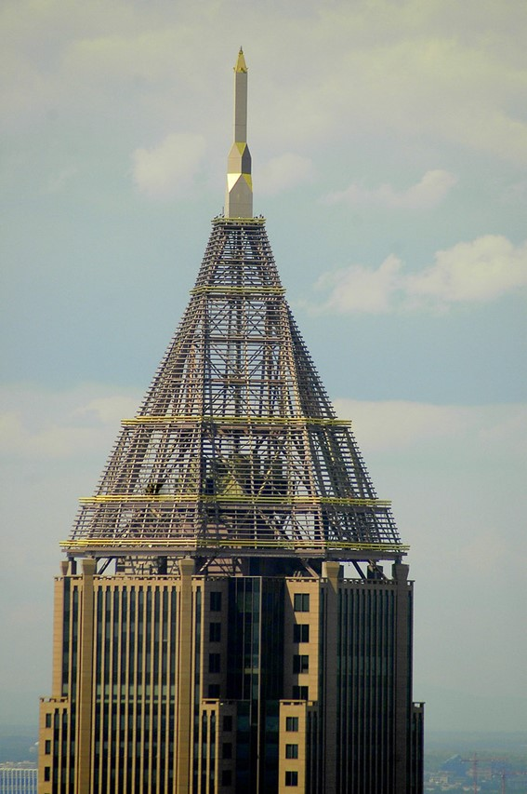
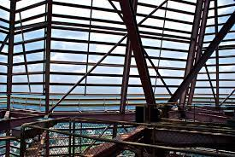


Geometry
Difficult to get the exact dimensions of the building
Model obtained from 3D Warehouse
Model scaled based on the height
Simplifications made
.ifc format

Slide 6
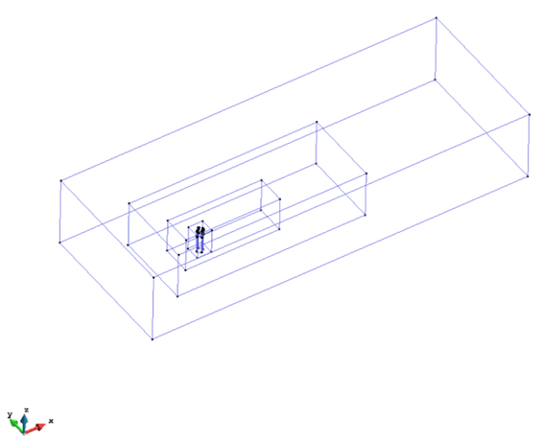
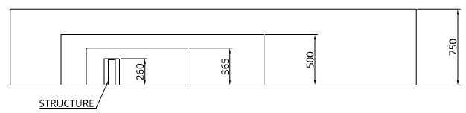
Simulation (Subdomains)
Subdomain boxes
500
750
1500
3000 (12H)
1000
250
500
1500 (6H)
1000 (4H)

Slide 7
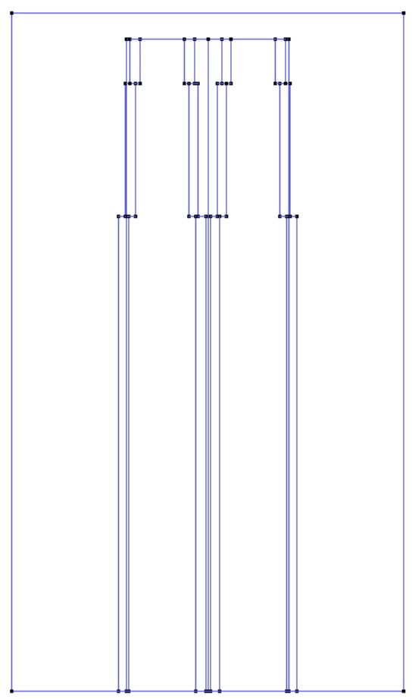
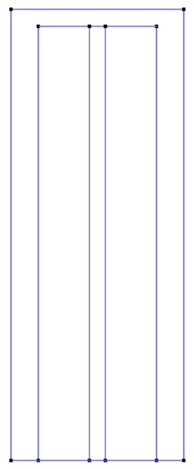
Simulation (Subdomains)
Subdomain boxes
250
260
150
100

Slide 8
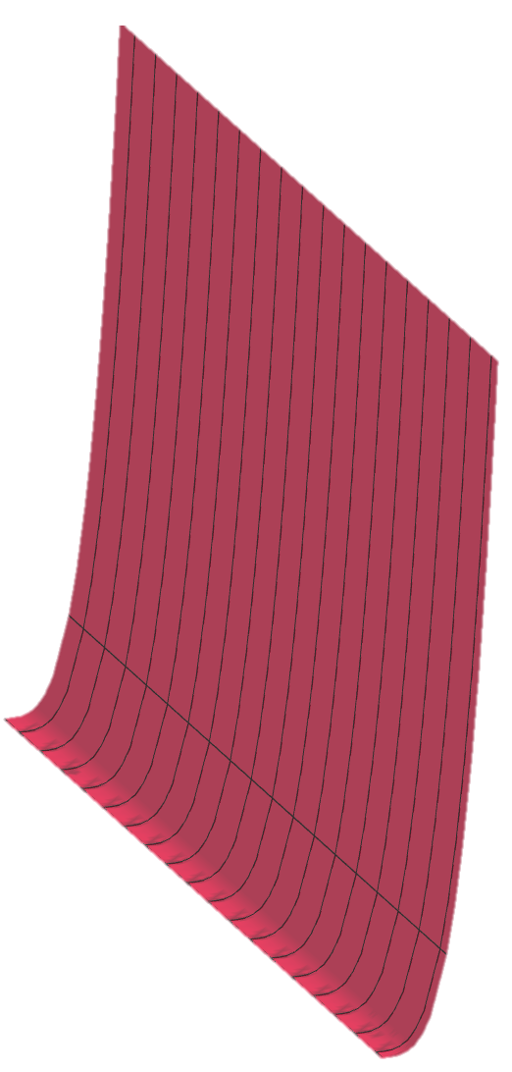
OUTLET.
ATMOSFERIC PRESSURE
Simulation (Mesh)
WALL & TOP. SLIP CONDITION
GROUND & STRUCTURE. NON SLIP CONDITION
WALL & TOP. SLIP CONDITION
INLET. CUSTOM VELOCITY

Slide 9
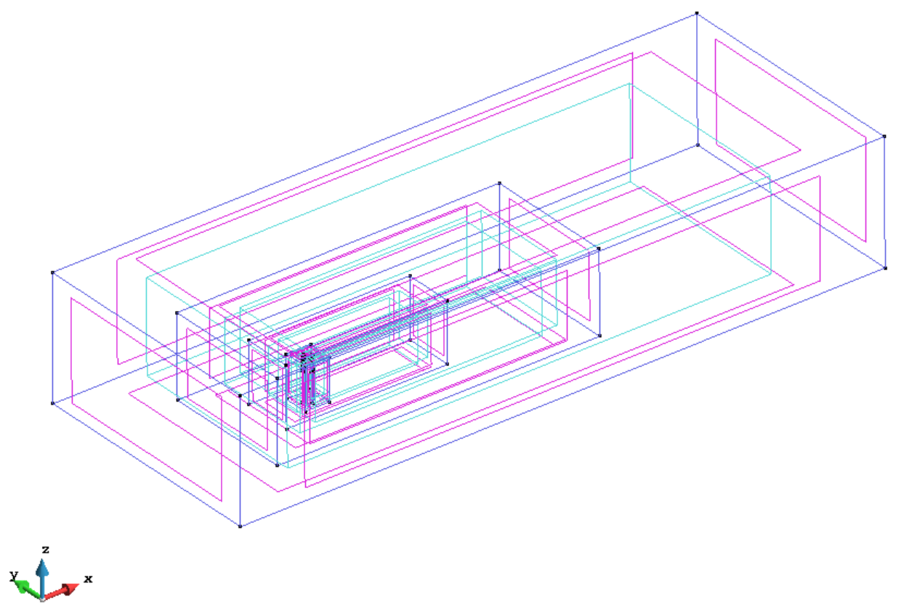
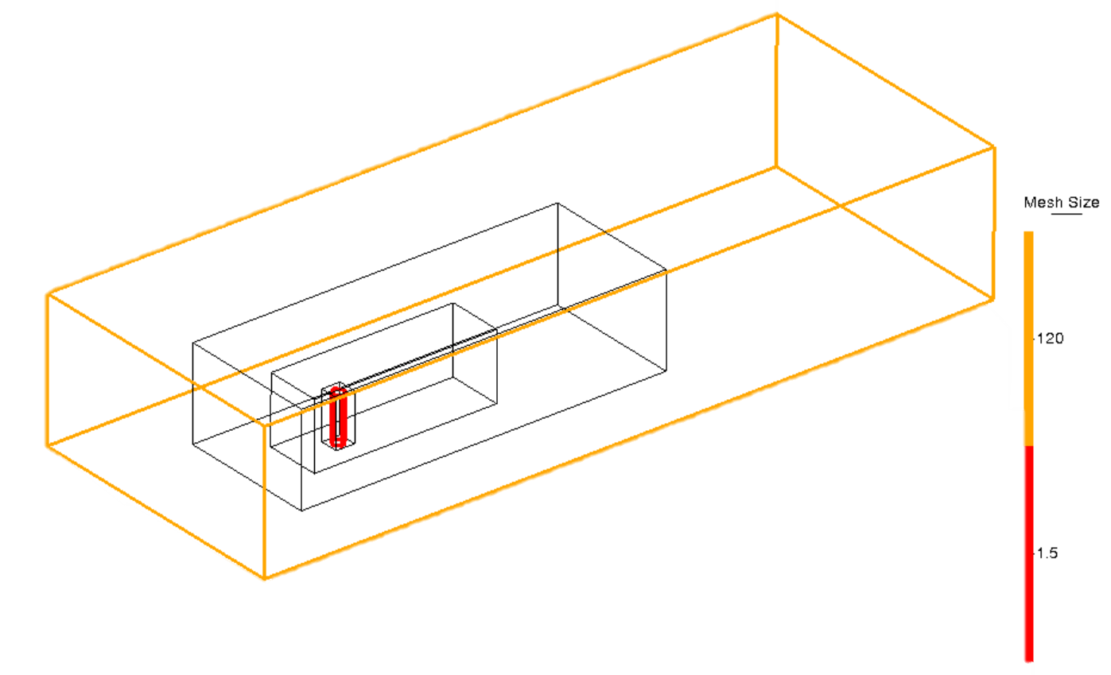
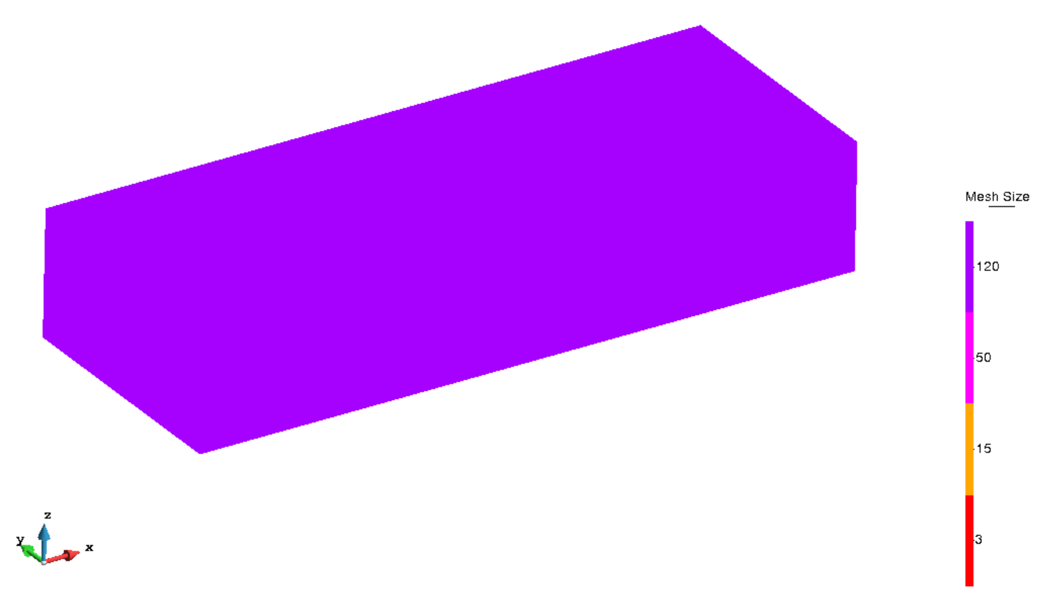
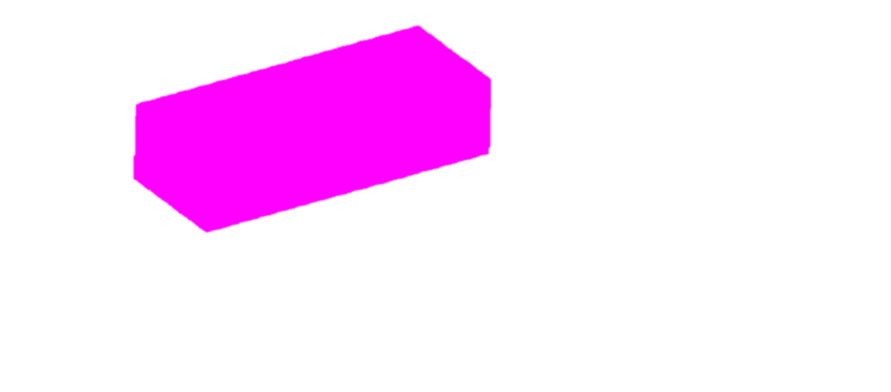


Simulation (Mesh)
Mesh size
120
Lines
1.5
120
 | Mesh quality
 | Simulation 1 |  | Simulation 2
Triangular | 4.54E4 | (>50º) | 4.25E4 | (>50º)
Tetrahedral | 2.90E6 | (>55º) | 2,48E6 | (45º-55º)
50
15
Surfaces and Volumes
3|2

Slide 10
Simulation (Kratos)
Time parameters
Time step = 0.03s
Total time = 250s
Time intervals
Ramp up (0,10)
Constant Flow (10, 250)
Mathematical model
Incompressible N-S eq.
Time integration Scheme
Second Order Backward Differentiation
Formula (BDF2)
Turbulence model
LES
One way coupling

Slide 11
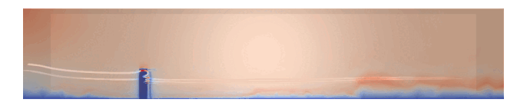
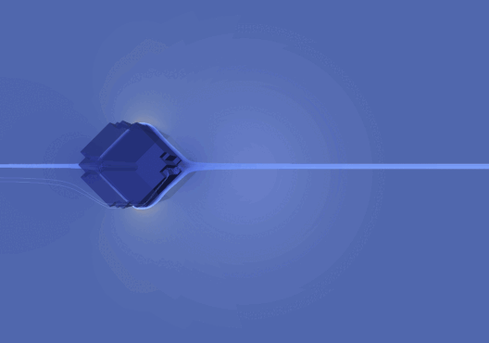
Simulation 1
Flow deformation after hit
Velocity decrease behind the building
Vortex shedding behind the building
Velocity increases at the edges
Fig. 1: Velocity lines in Paraview
Fig. 2: Velocity stream lines from Paraview
11
Technische Universität München 2022

Slide 12
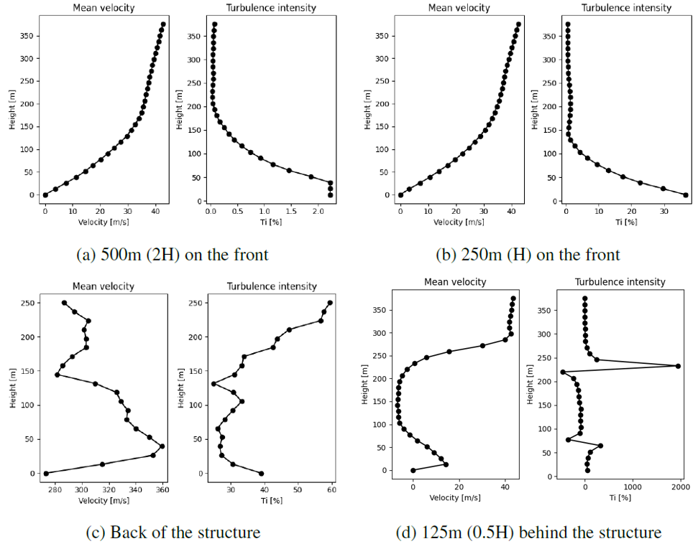
Simulation 1
No influence at H and 2H in front
0 velocity at 0 height due to no-slip BC
Turbulence behind the building
Deformed wind profile behind
Fig. 3: Mean velocities and turbulence intensities
12
Technische Universität München 2022

Slide 13
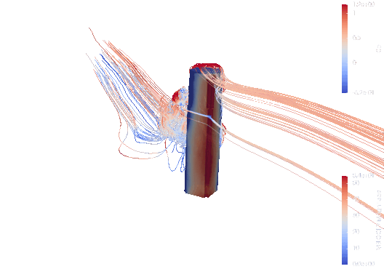
Simulation 1
Increase wind pressure at the edge
Focused on the upper part of the edge
Under pressure region at the back
Gradient pressure decrease on the sides
Fig. 4: Velocity stream lines from Paraview
13
Technische Universität München 2022

Slide 14
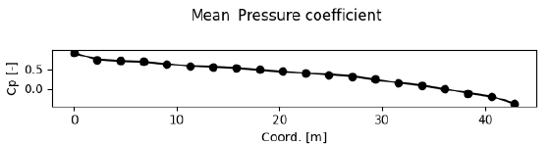
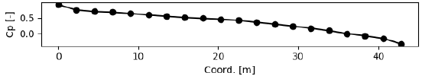
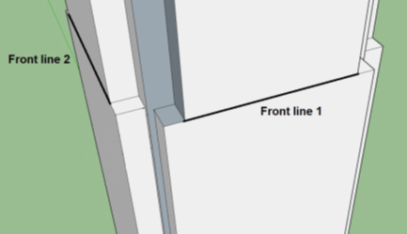
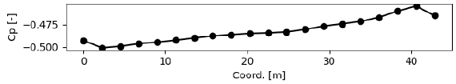
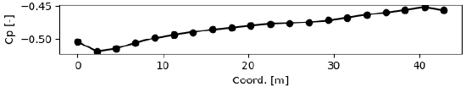
Simulation 1
Line 1
Line 2
Line 3
Line 4
4 assessment lines on the building at the height of 0.6H
Fig. 5: Pressure assessment lines locations.
Fig. 6: Mean pressure coefficients
14
Technische Universität München 2022

Slide 15

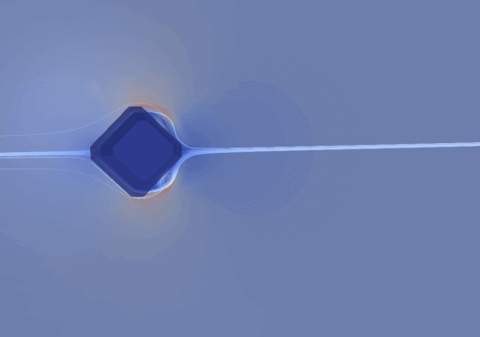
Simulation 2
Simplified geometry
Generally same behavior
Less turbulence at the back
Fig. 7: Velocity lines in Paraview
Fig. 8: Velocity stream lines from Paraview
15
Technische Universität München 2022

Slide 16
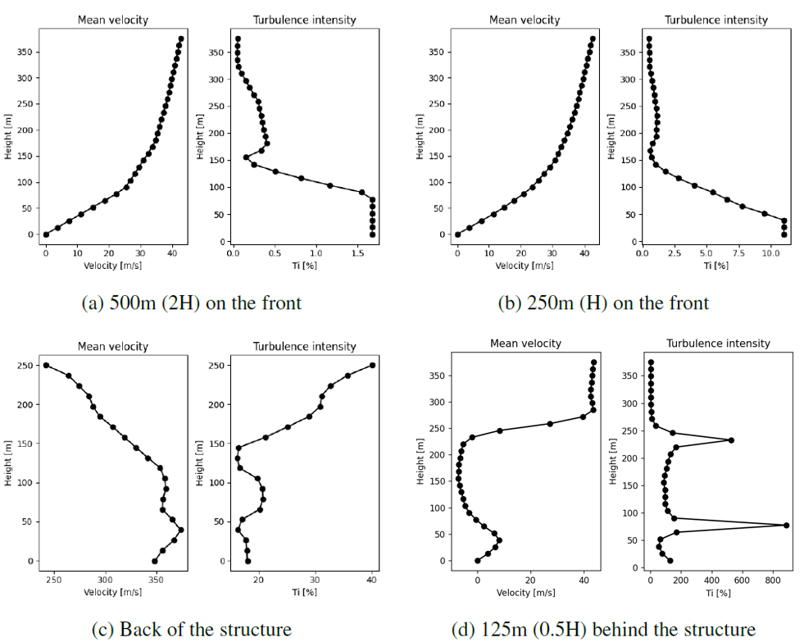
Simulation 2
Simplified geometry
Generally same behavior
Less turbulence at the back
Fig. 9: Mean velocities and turbulence intensities
16
Technische Universität München 2022

Slide 17
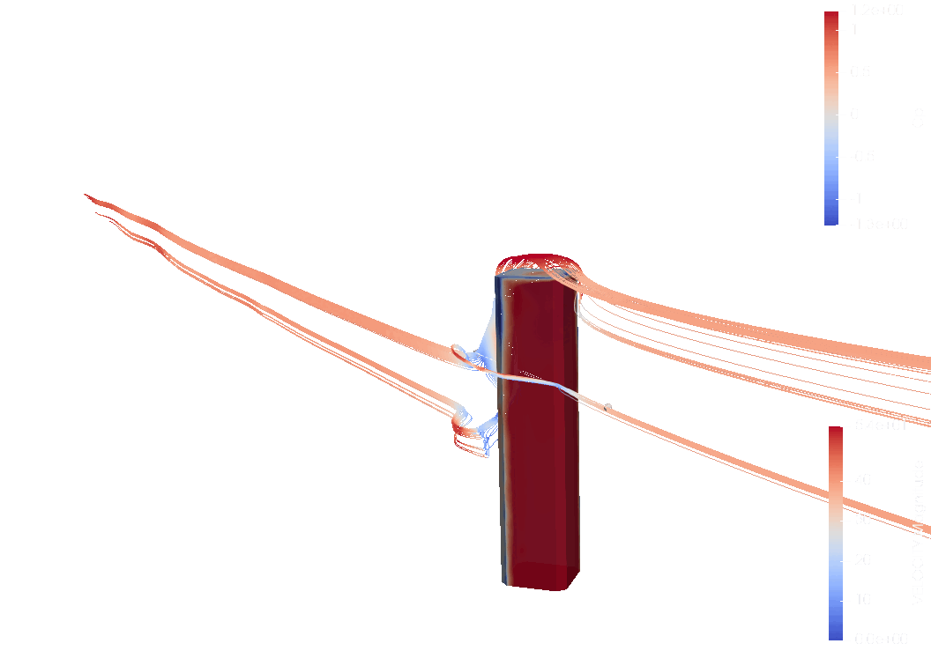
Simulation 2
Generally same behavior
No focus on the upper part of the edge due to simplified geometry
Fig. 10: Velocity stream lines from Paraview
17
Technische Universität München 2022

Slide 18
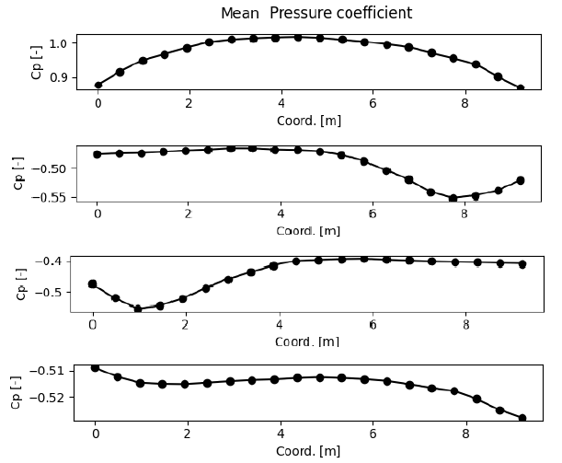
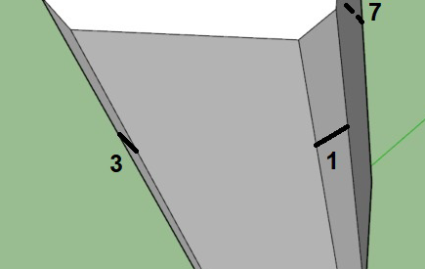
Simulation 2
Line 1
Line 3
Line 7
Line 5
4 assessment lines on the building at the height of 0.6H
Fig. 11: Pressure assessment lines locations.
Fig. 12: Mean pressure coefficients
18
Technische Universität München 2022

Slide 19
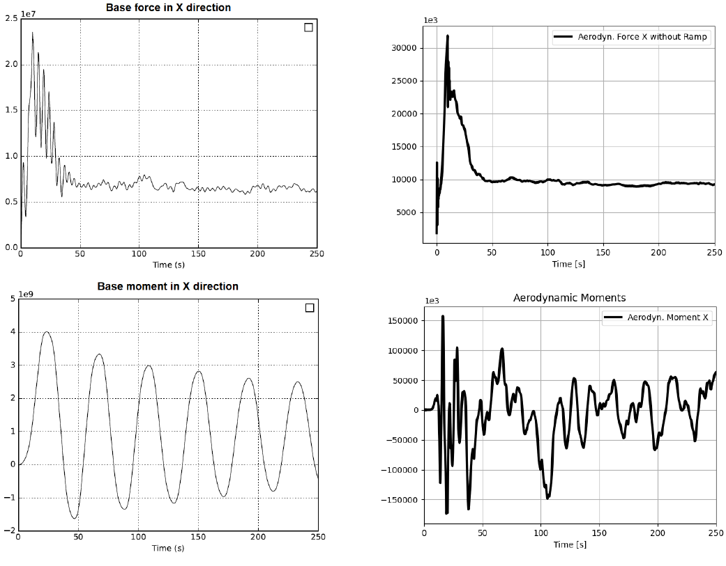
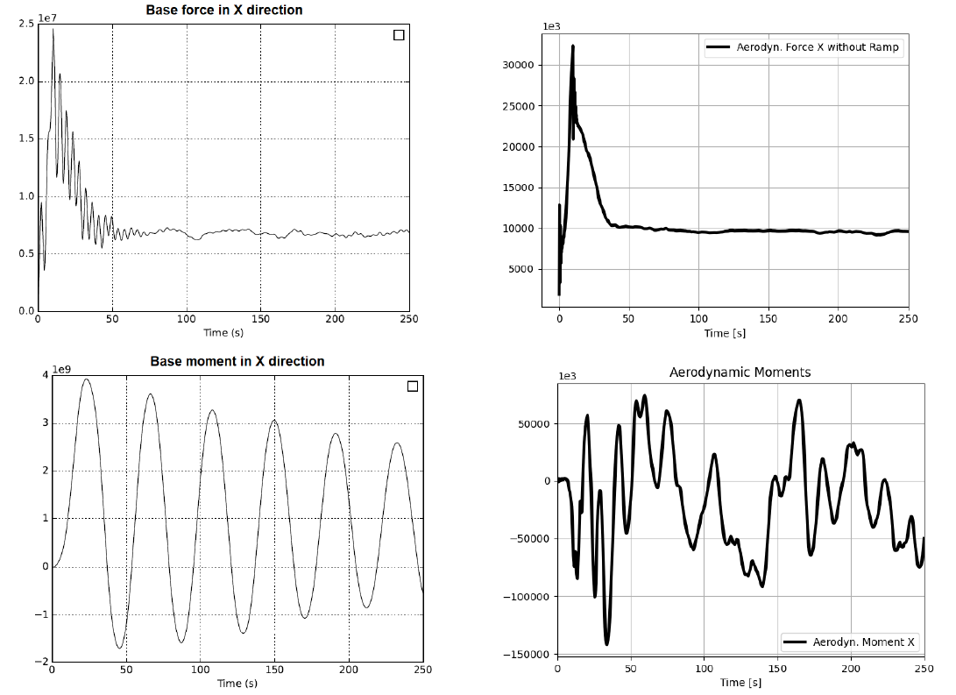
Base forces and moments analysis
Fig. 11: Forces and moments in x-direction simulation 1.
Fig. 12: Forces and moments in x-direction simulation 2.
19
Technische Universität München 2022

Slide 20
Conclusion
Wind behavior around the Bank of America Plaza has been studied using:
Eurocode-based analysis
Two CFD simulations
The effect of the building shape has been studied using:
Wind pressure
Velocity speed and deformation
Base forces and moments
20
Technische Universität München 2022

Slide 21
References
[1] Midtown, “Bank of America Plaza", 2022. [Online] www.midtownatl.com
[2] Meteoblue, “Wind rose“, 1992-2022 [Online] www.meteoblue.com
21
Technische Universität München 2022

Slide 23
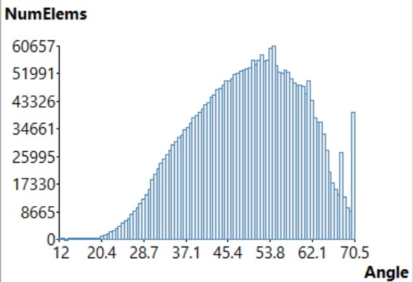
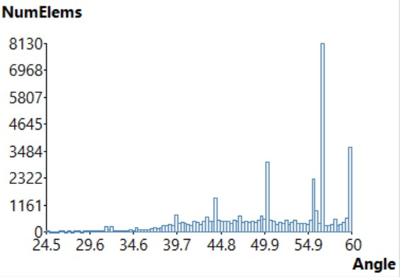
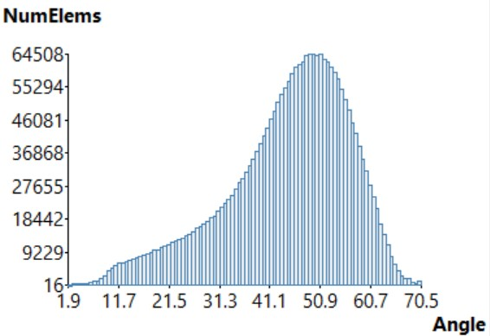
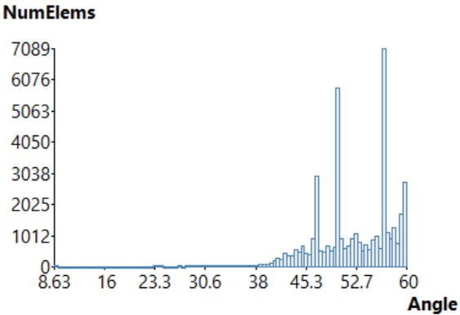
Simulation (Mesh)
Mesh quality
Simulation 1
Simulation 2

